Slide 1
Lead Scoring Case Study
By
Lokesh Bathula
Pankhudi Bhavate
Pavan Kumar C S

Slide 2
Problem Statement :
X Education sells online courses to industry professionals. The company markets its courses on several websites and search engines like Google.
Once these people land on the website, they might browse the courses or fill up a form for the course or watch some videos. When these people fill up a form providing their email address or phone number, they are classified to be a lead. Moreover, the company also gets leads through past referrals.
Once these leads are acquired, employees from the sales team start making calls, writing emails, etc. Through this process, some of the leads get converted while most do not. The typical lead conversion rate at X education is around 30%.
Business Goal:
X Education needs help in selecting the most promising leads, i.e. the leads that are most likely to convert into paying customers.
The company needs a model wherein you a lead score is assigned to each of the leads such that the customers with higher lead score have a higher conversion chance and the customers with lower lead score have a lower conversion chance.
The CEO, in particular, has given a ballpark of the target lead conversion rate to be around 80%

Slide 3
Approach
The problem is a classification problem. So we will use logistic regression to assign the user to either converted or non-converted category.
EDA is performed on the data set.
Feature selection is performed by eliminating the feature with high p value and VIF. This is resulted in 3 different models.
The model with VIF and p values below the desired values is selected
The model is evaluated for accuracy, sensitivity and specificity.
Precision and recall from the confusion matrix.

Slide 4
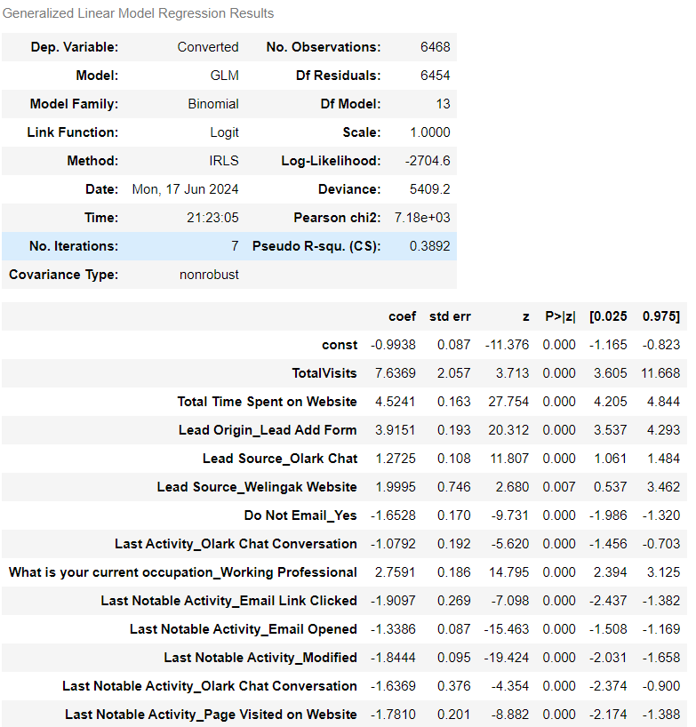
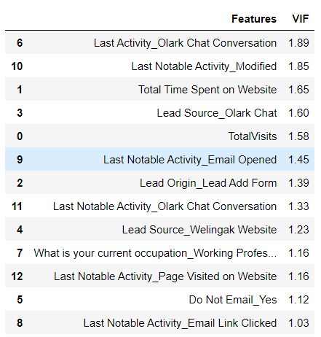
Model selection
The selected model has VIF and p values below the desired values

Slide 5
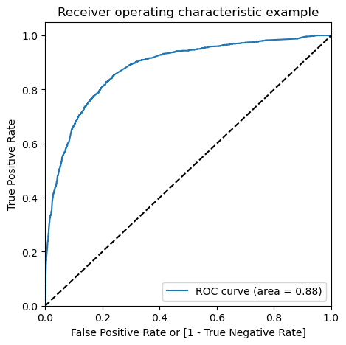
ROC curve
The area under Roc is 0.88 which is good

Slide 6
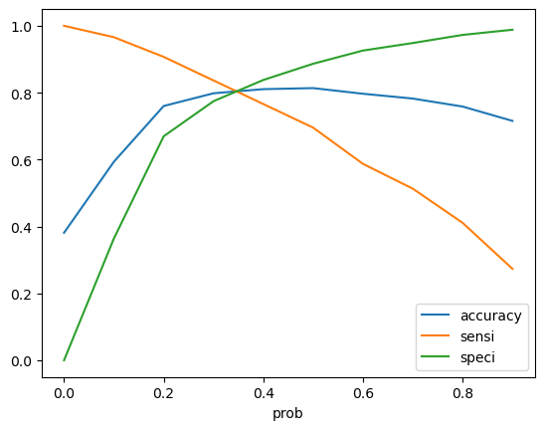
Determine cutoff
0.37 seems to be the cutoff

Slide 7
Results
Train data
Accuracy : 81%
Sensitivity : 78%
Specificity : 81%
Precision : 75
Recall : 75
Test Data
Accuracy :81%
Sensitivity : 78%
Specificity : 82%
Precision:77
Recall:77

Slide 8
Conclusion
Optimal cut off was selected based on the Sensitivity and Specificity of the model.
Accuracy, Sensitivity and Specificity values of test set are around 81%, 78% and 82% which are approximately closer to the respective values calculated using trained set.
The top 3 variables that contribute for lead getting converted in the model are
TotalVisits
Total Time Spent on Website
Lead Origin_Lead Add Form
overall this model seems to be good.

